Slide 1

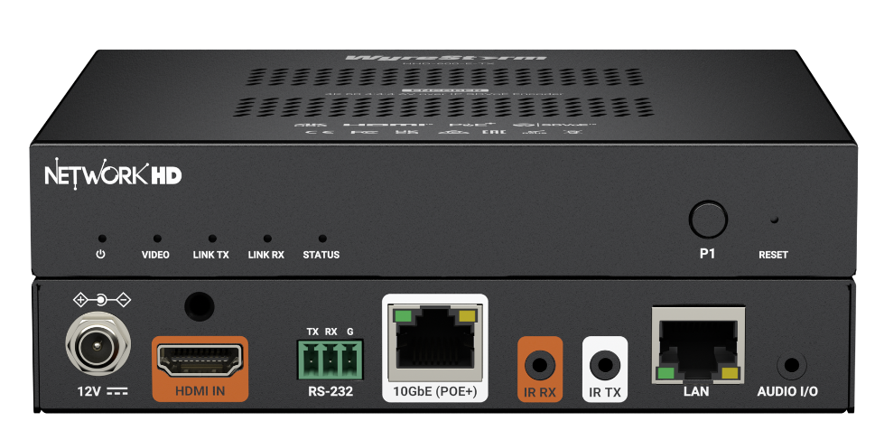
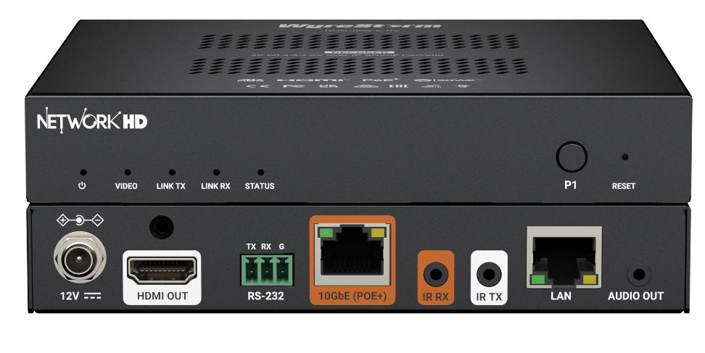

NHD-600-E-TX/RX
Product Guide
4K60 Zero Latency Lossless Encoder and Decoder
Award-Winning Audio-Visual Solutions Manufacturer
Notes:
1. 更新封面，不需要展示产品；

Slide 2

Contents
Key Features
Why Choose Us?
Interface & Specifications
Typical Connection & Applications
Competitor Analysis
Q & A Session
Product Overview
Powerful · Reliable · Simple

Slide 3
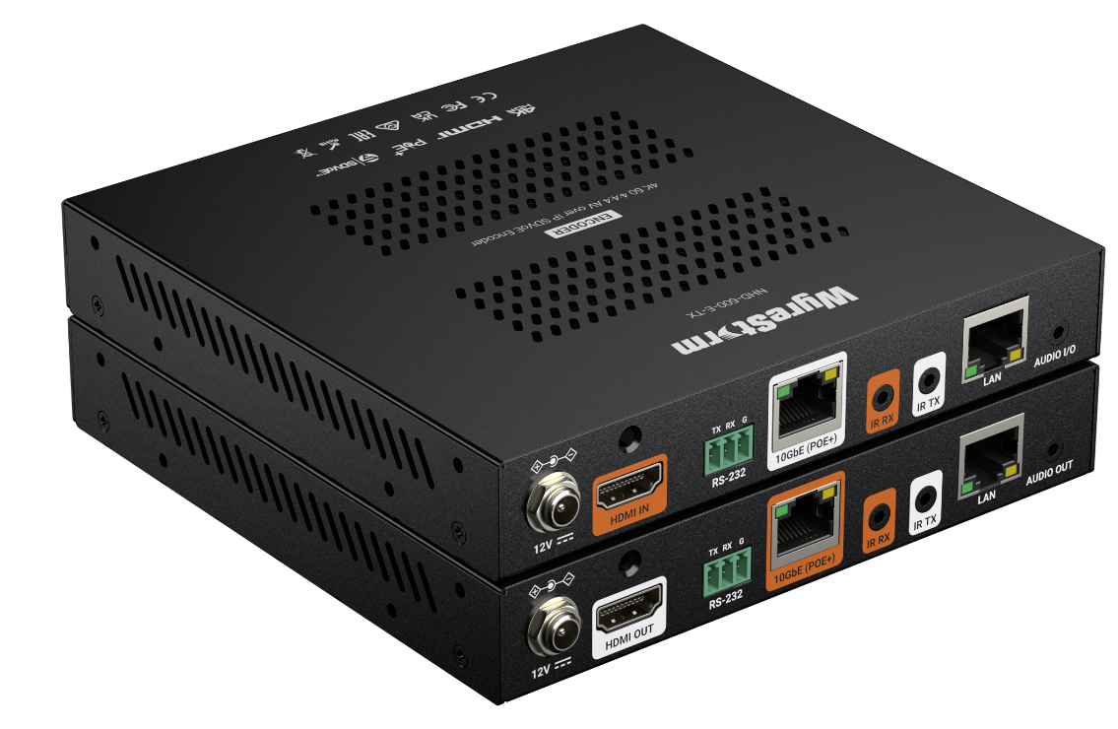
Product Overview
NetworkHD 600 Series Lite 4K60 Lossless Zero Latency Encoder and Decoder
The NHD-600-E encoder and decoder deliver cost-optimized, high-performance SDVoE AV over IP transmission and reception. The “E” variations remove some of the I/O found on the standard encoder and decoder, keeping only the core functionality required for most applications. Engineered for installations requiring pixel-perfect 4K60 4:4:4 video with zero-frame latency, this series supports robust 10GbE network operation with PoE+ and a flexible AV control suite.
As the economic extension of the NHD 600 Series, the NHD-600-E enables integrators to deploy reliable AV distribution for point-to-point or scalable matrix applications without unnecessary complexity or cost.
Powerful · Reliable · Simple

Slide 4




Main Features
Lossless Video Quality
Deliver pixel-perfect, lossless video with support for up to 4K60 4:4:4 over HDMI 2.0, including HDR formats such as HDR10, HLG, and Dolby Vision.
Zero-Latency Performance
Delivers zero-frame latency for real-time video transmission. This ensures perfectly synchronized audio and video, making it ideal for live presentation environments, control rooms, and interactive AV systems where timing accuracy is critical.
Flexible Connectivity Both the encoder and decoder feature HDMI 2.0 connectivity, along with analog audio connections and bidirectional IR and RS-232 passthrough, enabling seamless integration with external devices.
Cost-Effective Solution
Remove some of the I/O found on the standard encoder and decoder and retain only the core functions required for most applications
Powerful · Reliable · Simple

Slide 5
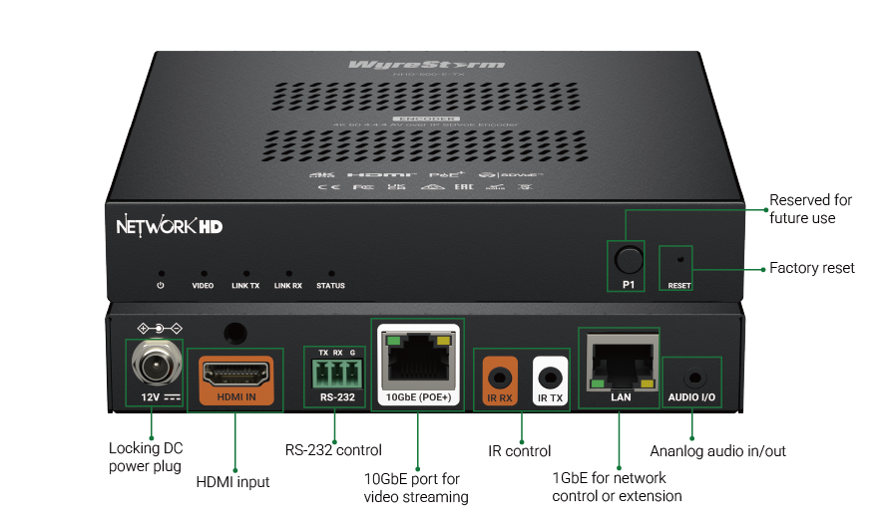
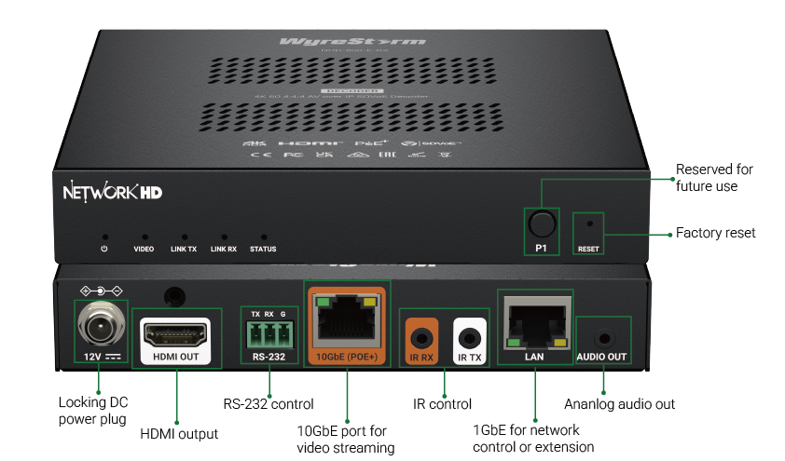
Interface of the Product
NHD-600-E-TX
NHD-600-E-RX
Powerful · Reliable · Simple

Slide 6
Specifications & Packing List
Specification
Video | Video Interface | 1x HDMI 2.0(For TX/RX)
 | HDCP | HDCP 2.3 compliant
 | Max. Video Resolution | *5120x2160@60Hz 4:2:0, 4096x2160@60Hz 4:4:4, 3840x2160@60Hz 4:4:4 *5K resolution only support in genlock mode
 | Scaler | Unsupported
Audio |  | 1x 3.5mm analog
Ethernet | 10G Ethernet | 1x RJ45
 | 1G Ethernet | 1x RJ45
Control | InfraRed | 1x IR In 1x IR Out
 | RS232 | 1x 3-pin Phoenix
Latency |  | < 120μs
What’s in the Box?
1x NHD-600-E-TX or NHD-600-E-RX
1x IR Transmitter(For TX) or Receiver(For RX)
2x Pair of Wall Mounting Ears
1x 12V 1A DC PSU with UK/US/EU/AU Pins
1x 3-pin 3.5mm Terminal Block
Powerful · Reliable · Simple

Slide 7
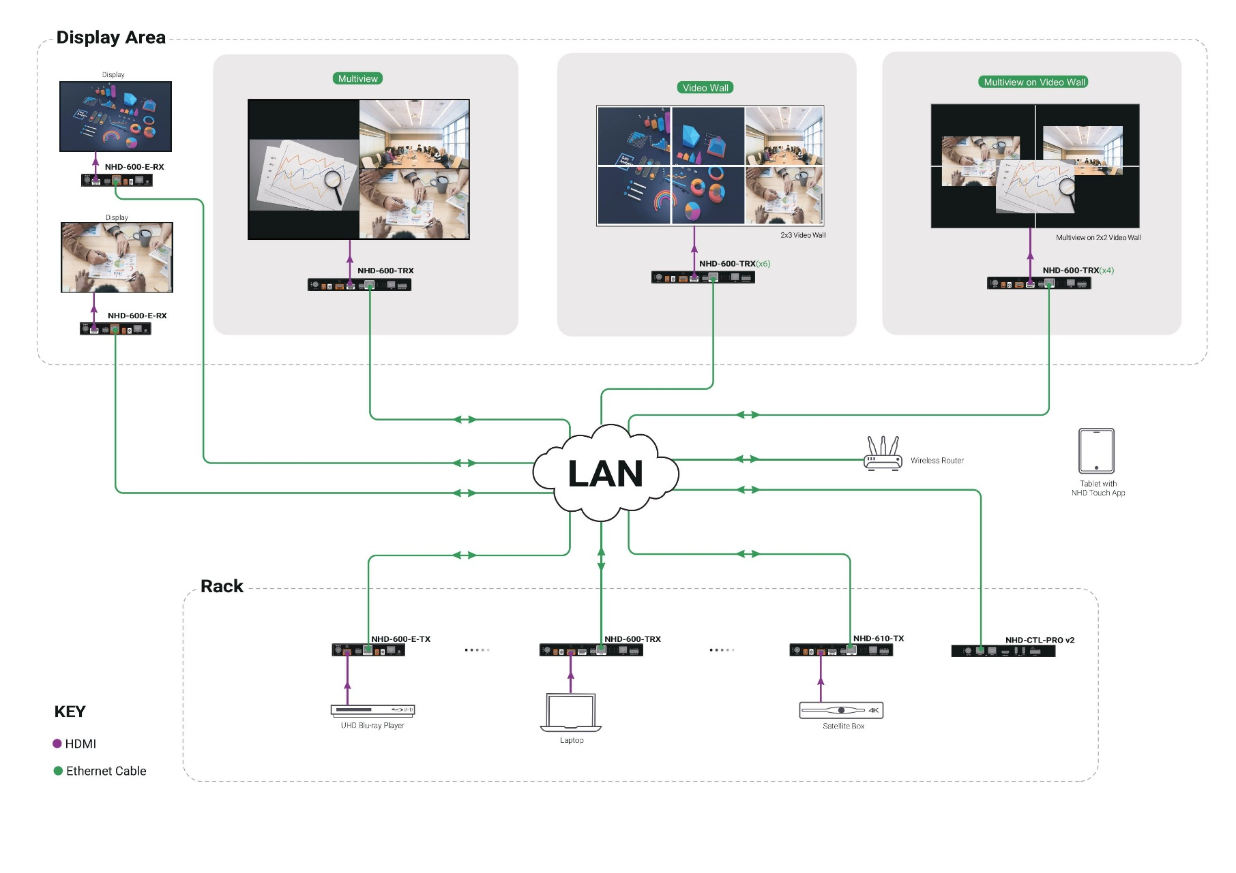
Typical Connection & Applications
The NHD-600-E is designed for point-to-point or point-to-many scenarios. It offers a cost-effective solution for zero-latency applications by removing USB, video wall, multiview and output scaling functions. The typical wiring diagram and application example are shown below.

Slide 8
Comparison with NetworkHD 600 Series
 |  | NHD-600-TRX | NHD-600-TRXF | NHD-610-TX v2 | NHD-600-E-TX | NHD-600-E-RX
Device Type |  | Transceiver | Transceiver | Encoder | Encoder | Decoder
Video | Input | 1x HDMI | 1x HDMI | 1x HDMI | 1x HDMI | No
 | Output | 1x HDMI | 1x HDMI | 1x HDMI(Loop out) | No | 1x HDMI
Audio | Analog Audio | 1x IN/OUT | 1x IN/OUT | 1x IN/OUT | 1x IN/OUT | 1x OUT
 | Dante Audio | No | No | Yes, also AES67 | No | No
Control | RS-232 | Yes | Yes | Yes | Yes | Yes
 | IR | 1x IR IN, 1x IR OUT | 1x IR IN, 1x IR OUT | 1x IR IN, 1x IR OUT | 1x IR IN, 1x IR OUT | 1x IR IN, 1x IR OUT
 | USB | 3x USB-A 1.1 1x USB-B 1.1 | 3x USB-A 2.0 1x USB-B 2.0 | 3x USB-A 1.1 1x USB-B 1.1 | No | No
Other features | SPF+ | No | Yes | No | No | No
 | RJ45 | 1x 1G (For control) 1x 10G(For AV) | 1x 1G(For control) | 1x 1G(For control) 1x 10G(For AV) | 1x 1G (For control) 1x 10G(For AV) | 1x 1G (For control) 1x 10G(For AV)
 | PoE+ | Yes | No | Yes | Yes | Yes
 | Video Wall | Yes, up to 8x8 | Yes, up to 8x8 | Yes, up to 8x8 | Yes | No
 | Multiview | Yes, up to 16 windows | Yes, up to 16 windows | Yes, up to 16 windows | No | No

Slide 9
Comparison with Other Competitors
Specification |  | WyreStorm NHD-600-E-TX/RX | Lightware HDMI-TPX-TX/RX107
Video | Video Interface | 1x HDMI 2.0(For TX/RX) | 1x HDMI 2.0(For TX/RX)
 | HDCP | HDCP 2.3 compliant | HDCP 2.3 compliant
 | Max. Video Resolution | Up to *5120x2160@60Hz 4:2:0, 4096x2160@60Hz 4:4:4, 3840x2160@60Hz 4:4:4 | Up to 4096x2160@60Hz 4:4:4 or 3840x2160@60Hz 4:4:4
 | Scaler | Unsupported | Unsupported
Audio | Audio | 1x 3.5mm analog | N/A
Ethernet | 10G Ethernet | 1x RJ45 | 1x RJ45
 | 1G Ethernet | 1x RJ45 | 2x RJ45
Control | InfraRed | 1x IR In 1x IR Out | 1x IR Out
 | RS232 | 1x 3-pin Phoenix | 1x 3-pin Phoenix
Latency | Latency | < 120μs | < 120μs

Slide 10

Final Thoughts
Q & A Session
Got questions? Don’t hesitate to ask away.
Powerful · Reliable · Simple

